Slide 1
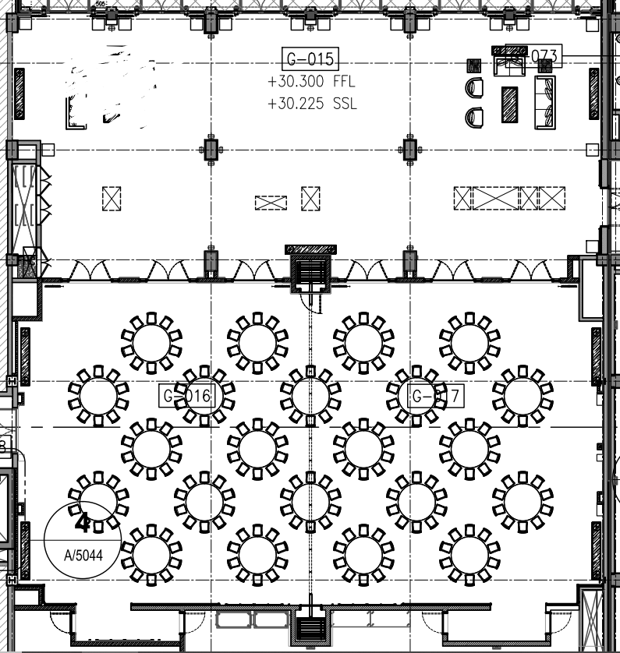

Slide 2
DRINKS STATION
(team coffee, chilled juices, softdrinks and still mineral water)
BUFFET STATION
EXISTING SOFA SEATING
10
8
AISLE
7
9
6
4
3
5
2
1
Dance Floor (5mx5m – this will be provided by the hotel)
Small Stage with 1 rectangular table for the couple (stage from the events planner)
DJ

