Slide 1

8
4
1
7
6
3
5
N/A
SIDE STATION
9
10
11
N/A
DISPLAY
14
15
N/A
Bar Area
Entrance 2
Section 3
Section 2
Section 1
N/A
SIDE STATION
Entrance 1
Kitchen
Outlet floor plan
Notes:
REGULAR FLOOR PLAN - DAILY OPERATIONS -

Slide 2
8
PIZZA STATION
MUSHROOMS RISOTTO IN CHEESE WHEEL
7
6
MIRROR
SIDE STATION
9
10
11
N/A
Bar Area
Section 3
Section 2
Section 1
SITE STATION
N/A
Entrance 1
KITCHEN PASS
Outlet floor plan
Notes:
DRAFT FOR LAYOUT

Slide 3
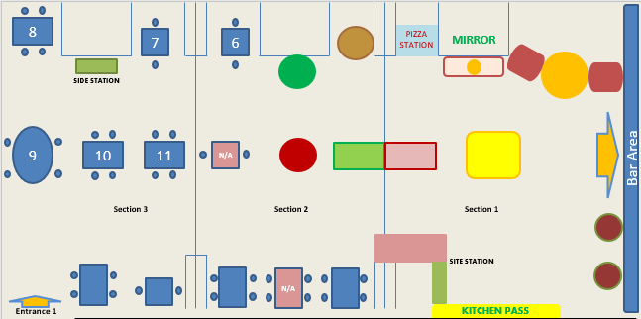
ALIVE STATION with 3 SORTS of PASTA COOKED BY CHEFS
SPIRITS STATION by
EXTRA PRICE
BREAD STATION
MUSHROOMS RISOTTO IN CHEESE WHEEL
ROASTED BEEF and LAMB
SAUSAGES and/or COOKED SIDE DISHES (VEGETABLES)
WINE STATION
FRESH SALADS STATION
COLD CUTS STATION
CHEESES SELECTION
DESSERTS SELECTION
Notes:
NEW BRUNCH TABLES LAYOUT - MODIFIABLE FILE -

Slide 4
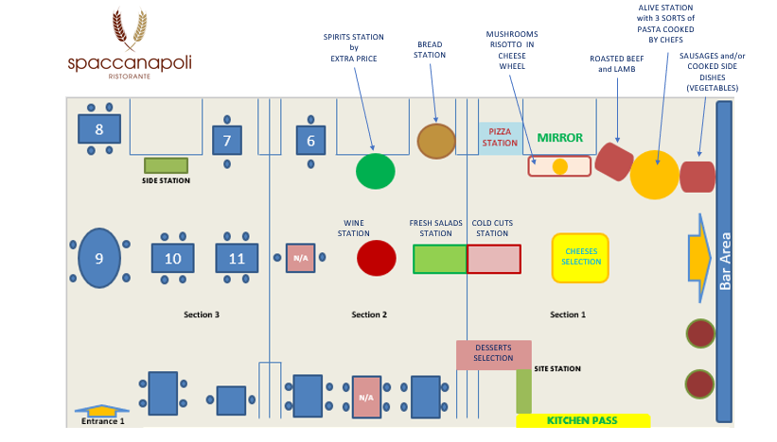
Notes:
NEW BRUNCH TABLES LAYOUT - NON MODIFIABLE FILE -

